Slide 1
Tips for Virtual Networking Platform
of 2022 VLSI-TSA and VLSI-DAT Symposia

Slide 2
Virtual Networking Platform
Access the Virtual Networking Platform:
TSA: https://meeting.vmi.tw/tsa
DAT: https://meeting.vmi.tw/dat
Please log in with your email and registration number
(same as in the registration notice letter).

Slide 3
Virtual Networking Platform Instructions
This virtual networking platform will open from April 18th, 9:30 am to April 30th, 2022 23:59 pm. All schedule is in Taipei Time (GMT+8).
Live Sessions:
This event page allows participants to view the following sessions Live online. Click “ ” to navigate the live sessions:
- Joint Opening & Award Ceremony
- Joint Plenary sessions (J1, J3, J6)
- Joint Special Sessions (J2, J5)
- Joint Luncheon Keynote (J4)
2) Participants who attend the symposia virtually can post questions through Microsoft Teams chatroom during
live Q&A.
Virtual Chat Room:
The Chat Room creates a platform for participants to network with leading experts worldwide. After viewing
presentation, participants can go to the Chat Room below (click “ ”) and interact with the speaker of each
paper.
To establish effective engagement, audience are suggested to post your questions on the chat
room before 18:00 (GMT+8) on the speech day. Authors/speakers are encouraged to reply to the
questions before 18:00 (GMT+8) on the next day of your speech.

Slide 4
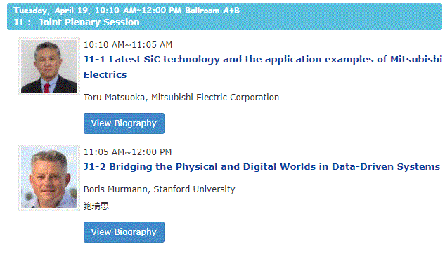
Virtual Chat Room : 4/18-4/30
Step 1 : Visit Program page of the conference website and click “Chatroom” button, or Scan the QR code on the session board to access the Chatroom.
Step 2 : Login with your email and registration number.
Step 3 : Click to enter the Chatroom or reach out to speakers via email.

Slide 5
Live Sessions(Joint Session Only) : 4/19-4/21
Step 1 : Visit Program page of the conference website and
click “Chatroom” button, or Scan the QR code on the
session board to access the Chatroom.
Step 2 : Login with your email and registration number.
Step 3 : Click button, you can watch Live Sessions.

